Slide 1
Social Media Sentiment Analysis for Product Feedback
Data Nexus
Team members-
Ruchi Jha
Tanvi Takavane
Neha Patil

Slide 2
Introduction
Social media is filled with user opinions, especially when new products are released.
Businesses need a way to track and understand customer reactions in real time.
Our goal is to analyze social media sentiment to help companies make smarter decisions after product launches.
This enables companies to respond quickly to negative feedback and amplify positive engagement.
It also supports product teams in identifying common issues and feature requests from real users.

Slide 3
Core Problem:
"Can we build a model that analyzes social media posts to determine public sentiment toward newly launched products?"
Our project aims to build a sentiment analysis pipeline that processes social media data, identifies the public's emotional response to product launches, and classifies those responses into sentiment categories such as positive, negative, or neutral.
By doing this, businesses will be able to:
Monitor how their products are being received in real-time.
Adjust marketing strategies based on sentiment trends.
Improve product features or services in response to common complaints or praise.
Engage with customers more effectively by understanding their concerns.
This system acts like a digital “feedback radar,” giving companies a way to tune into the voice of the customer without needing formal surveys or reviews.

Slide 4
About the Dataset
Source: Kaggle – "Social Media Sentiments Analysis Dataset" by Kashish Parmar
Size: 732 rows and 15 columns
Dataset Creation:
Scraped from various social media platforms using APIs and public datasets
Labeled using a combination of keyword-based filtering and manual verification
Key Feature: Sentiment
Categories of sentiment : 279
P A R T 0 1

Slide 5
Tools & Technologies Used
Python (Pandas, Numpy, Scikit-learn, NLTK, Matplotlib, Seaborn)
Jupyter Notebook
Kaggle Dataset

Slide 6
Data Cleaning & Preprocessing
Dropped unwanted columns
Renamed column Unnamed column to ID
Converted Timestamp to Datetime format for standardization
Removed leading and trailing spaces from string based columns
Checked for missing values - No missing values found

Slide 7
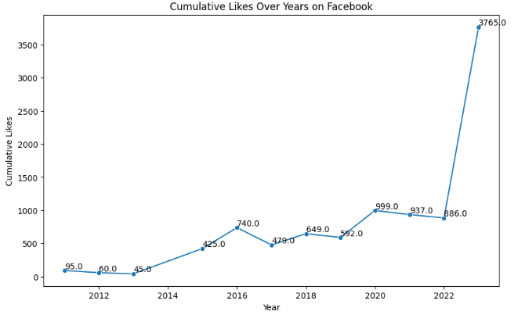
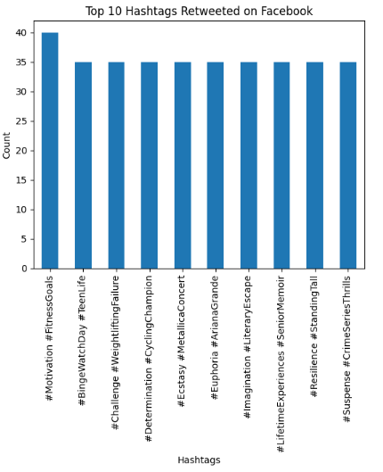
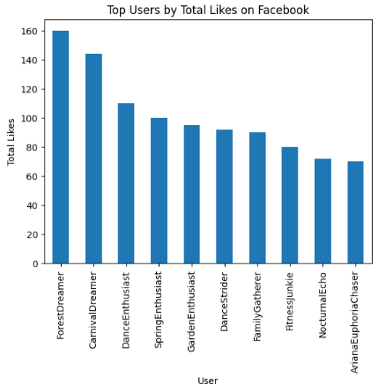
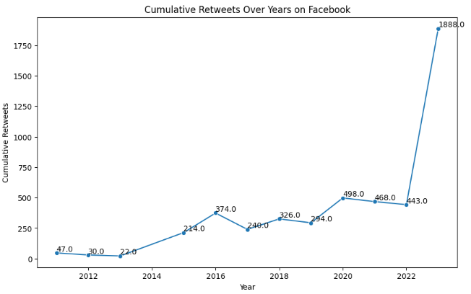
Plots for different Platforms:
Facebook

Slide 8
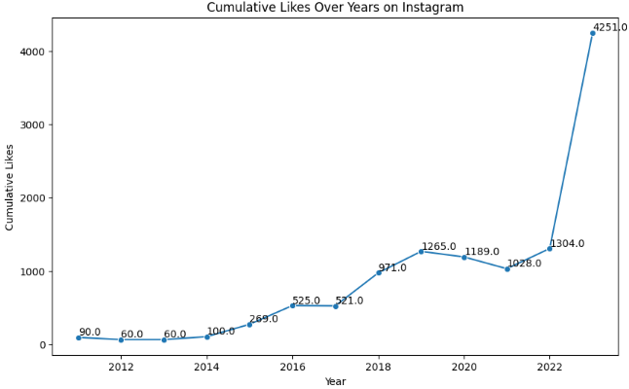
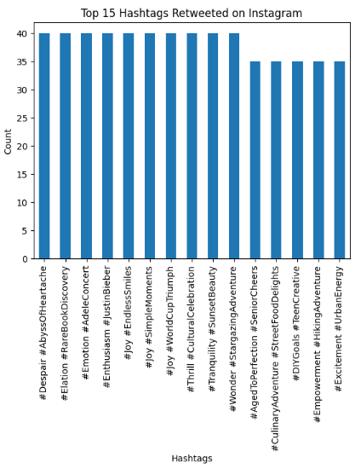
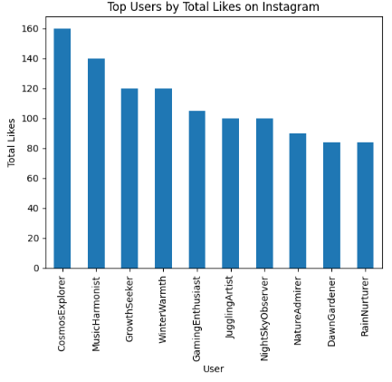
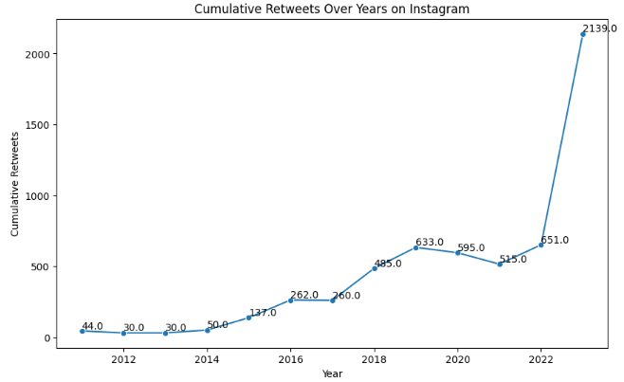
2. Instagram

Slide 9
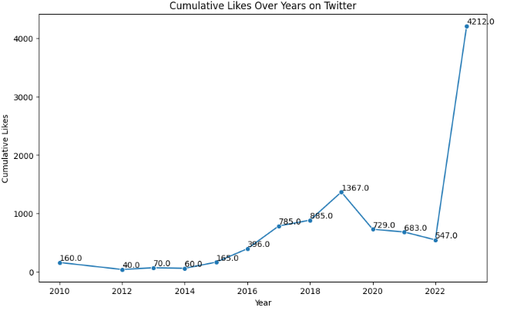
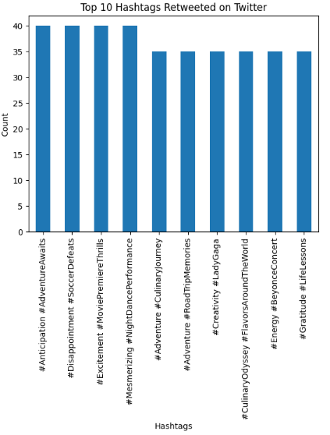
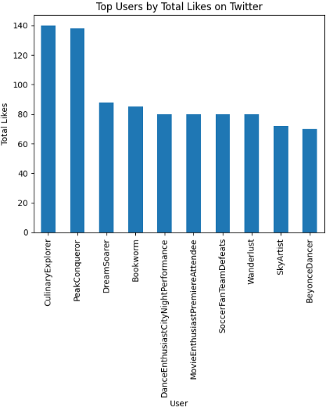
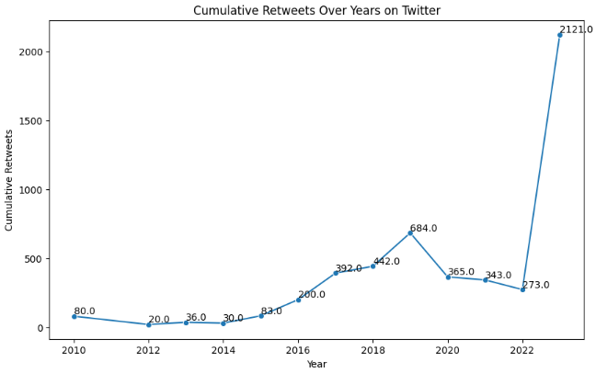
3. Twitter

Slide 10
Thank you

